Slide 1
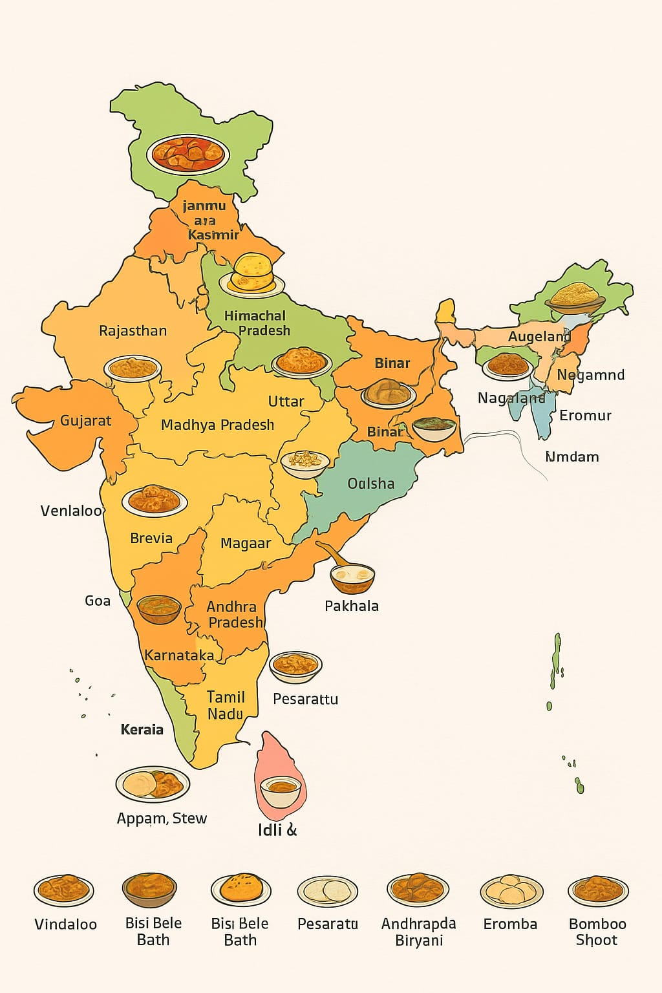
TASTES OF INDIA
HERITAGE OF INDIAN FOODS

Slide 2

PROBLEM STATEMENT:
"Traditional Indian foods and recipes are slowly being forgotten in the digital era. There is a lack of an engaging platform that preserves and promotes the heritage, cultural significance, and regional diversity of India's traditional cuisines.“
WHO IS FACING THIS ISSUE?
Young generation unaware of traditional cuisines
Local chefs and food vendors without online visibility
Tourists seeking authentic Indian food experiences
Cultural educators and heritage enthusiasts
WHY IT IS IMPORTANT TO SOLVE IT NOW?
Heritage recipes are disappearing with modernization.
Youth are disconnected from cultural roots.
Lack of digital documentation of traditional foods.
Growing global interest in Indian cuisine.
Need to preserve and promote India’s food heritage before it’s lost.

Slide 3

SOLUTION OVERVIEW:
WHAT DOES OUR IDEA DO?
"Tasters of India" is a digital platform that preserves and promotes India's traditional cuisines. It connects users to heritage foods through an interactive map, authentic recipes, local vendor stories, and cultural insights helping people rediscover India's food heritage in the digital age.
KEY FEATURES OR TECHNOLOGY INVOLVED:-
KEY FEATURES:
Interactive map showing each state's traditional foods
Digital recipe preservation & uploads
Local chef/vendor promotion
Multilingual cultural food stories
Community sharing & tourism insights
Technology Involved:
React.js, Node.js, MongoDB
Google Maps API, Firebase
Optional Al for food image recognition
Cloud hosting on AWS/Firebase

Slide 4

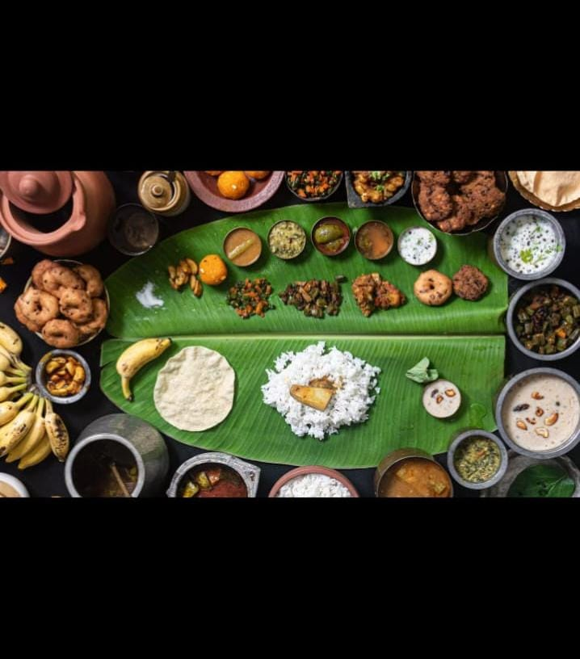
WHY OUR TEAM PROJECT IS UNIQUE AND INNOVATIVE:-
First platform to combine heritage, culture, and technology through food.
Interactive India map to explore traditional dishes state-wise.
Encourages digital preservation of family recipes and local vendors.
Uses Al, cloud, and multilingual tech to connect generations.
Promotes Indian food heritage globally in an engaging, visual way.

Slide 5
DESIRABILITY (USERS NEED):
WHO ARE OUR TARGET USERS?
Food lovers and travelers
Students and researchers of Indian culture
Local food vendors and artisans
Health-conscious people
Tourists exploring Indian cuisines
WHAT MAIN POINT DOES THIS SOLVE?
Loss of traditional food knowledge due to modernization.
Lack of awareness about the cultural value behind regional dishes.
Difficulty in discovering authentic local foods while traveling.
Limited digital platforms that preserve and promote heritage culture.
ANY USER TERMINALS OR VALIDATION:
Users rediscovered forgotten traditional recipes.
Tourists found authentic local foods easily.
Students loved learning culture through food.
Local vendors gained more visibility and customers

Slide 6





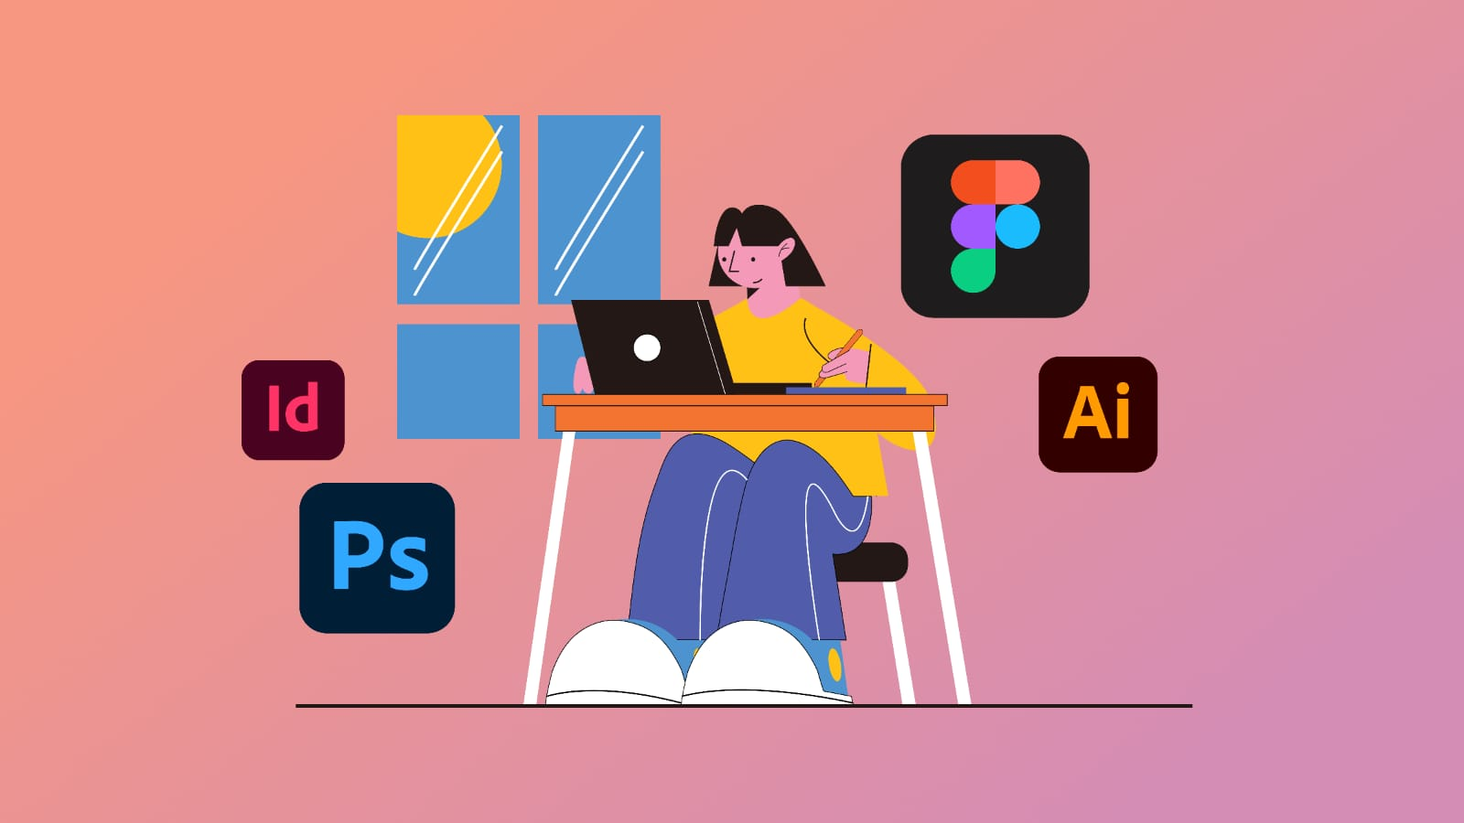
FESEABILITY (CAN WE BUILD IT):
TOOLS,PLATFORMS AND TECH SACK USED:
Frontend: HTML, CSS, JavaScript
Backend: Python / Node.js
Database: Firebase / MySQL
Platform: Web & Mobile (Android & iOS)
APIs & Tools: Google Maps API, Cloud Storage, Al-based suggestions
Design Tools: Canva, Figma.

Slide 7
DEVELOPMENT ARCHITECTURE OR PLAN:-
Phase 1- Research & Data / MySQL
Phase 4 - Testing & Deployment: Tested app
performance and deployCollection:
Gathered information on regional heritage foods.
Phase 2 - Design: Created UI/UX in Figma & Canva for an engaging user experience.
Phase 3 - Development:
Frontend: HTML,CSS,JavaScript
Backend: Python / Node.js
Database: Firebase ed on Web & Mobile platforms.
Architecture: Follows Client-Server model with secure cloud storage for data access.

Slide 8

VIABILITY (IS IT SUSTANIABLE):-
REVENUE MODEL OR MPACT MODEL:
Revenue Model:
Advertisments from local food business and brands.
Premimum content for exclusive recipes and cultural insights.
Partnerships with tourism boards,resturantsand artisans.
E-commerce integration for traditional ingredients or recipe kits.
Imapct model:
Preserves India’s culinary heritage for future generations.
Promotes local business and artisans.
Educates users about culture,history and nutrition.
Encourages sustainableand healthy eating habits.

Slide 9

TARGET MARKET PRIZE:
Food Enthusiasts & Tourists: Seek authentic regional dishes and food trails.
Young Consumers (18-35 yrs): College students, vloggers, and professionals interested in traditional and healthy foods.
Local Food Vendors: Promote regional recipes
and cultural dishes through digital exposure.
Cultural & Tourism Bodies: Use the platform for heritage food events and collaborations.
MARKET DEMAND:
India's food tourism market is valued at $50+ billion, growing 10-15% annually.
Increasing awareness of traditional, healthy, and organic food habits.
Supported by initiatives like "Vocal for Local" and "Incredible India."
Rising trend of food vlogs, reels, and culinary travel.
PRICE MODEL:
Free Users: Explore dishes and recipes.
Premium Users: ₹99-₹199/month for exclusive content & cultural stories.
Vendors: ₹500-₹1000/month to promote their heritage food stalls online.

Slide 10
COST ESTIMATES :
Estimated Initial Costs (Prototype Stage)
App / Website Development: ₹30,000 - ₹50,000
Hosting & Cloud Services: ₹5,000 - ₹10,000 /year
Content Collection (Recipes, Photos): ₹10,000- ₹15,000
Marketing & Social Media: ₹5,000 - ₹8,000
Maintenance & Updates: ₹3,000 / month
Total Estimated Cost: ₹60,000 - ₹85,000
SCALABILITY PLAN:
Phase 1 - Local Launch: Start in one state (e.g., Tamil Nadu) with local vendors.
Phase 2 - Regional Expansion: Add cuisines from multiple states.
Phase 3 - National Growth: Partner with tourism boards and food influencers.
Phase 4 - Global Reach: Introduce "Virtual Food Tours of India" for global users.
SCALABILITY HIGHLIGHTS:
Cloud-based platform to support large user growth.
Vendor onboarding ensures sustainable revenue.
Integration with tourism & cultural departments boosts reach.

Slide 11

PROTOTYPE/DEMO:
OVERVIEW:
Our prototype is a mobile + web platform that helps users explore and experience India's heritage foods through an interactive interface.
Key Features
Explore traditional dishes state-wise
Interactive Heritage Food Map
Vendor Connect - discover and promote local cooks
Cultural Gallery - images, ingredients, and preparation videos
Save & Share - favorite dishes and food trails.
Demo Workflow
1. Open home screen India map view
2. Select a state View famous regional foods
See recipe, ingredients & 3. Click a dish
vendors
4. Add to favorites / share with friends.
Technology Stack
Frontend: React Native / Flutter
Backend: Firebase / Node.js
Database: Firestore / MongoDB
API: Google Maps, Cloud Storage
UI Design: Figma / Canva

Slide 12
Outcome:
"Tasters of India" offers a virtual food journey across the nation - blending culture, cuisine, and community in one interactive experience.
User Flow / Key Interactions
1. Home Screen: Interactive map of India displaying states.
2. Select a State: Shows regional heritage foods with images.
3. Dish Details Page:View recipe, ingredients, and short history.Option to mark as favorite or share.
4. Vendor Connect: Contact or locate nearby traditional food sellers.
5. Cultural Gallery: Watch preparation videos or scroll photo stories.
6. Profile Section: Personalized favorites, saved dishes, and user badges.
UI Highlights
Warm earthy color theme - saffron, beige, and brown.
Visual map navigation for cultural immersion.
Card-style food display with minimal text & large images.
Bottom navigation bar → Home | Map |Vendors | Gallery | Profile.
Search & filter options by region, ingredient, or festival.
Mini cultural notes or quotes on each dish card.

Slide 13
HOW IT ACTUALLY WORKS:
1. User Opens App
2. Browse India Map / List of States
3. Select a State
4. View Heritage Food Details
*Name
*History & Cultural Significance
*Ingredients
*Recipe / Video
5. Interactive Features
*Rate & Review
*Share
*Add to Favorites
6. Personalization
*Recommendations
*Badges / Achievements
7. Educational Content
*Fun Facts
*Stories & Traditions

Slide 14

OUR ROADMAP:
WHAT WE BUILT SO FAR?
1. We are researching India's heritage foods and cultural stories.
2. Planned target users: tourists, young consumers, and local vendors.
OUR NEXT 30-60-90 DAYS PLAN:
30 DAYS
. Finalize and refine the app wireframes and user flow.
Begin developing
60 DAYS
Develop a working prototype based on wireframes.
Upload sample dishes and vendor listings for 5-6 states.
Implement basic interactions: map navigation, dish details, favorites.
Start testing user flow and collecting feedback.
Refine UI/UX design based on initial tests.
90 DAYS
Complete full app prototype with multi-state dishes and vendor listings.
Implement advanced features: search, filters, cultural stories, and gallery.
Conduct user testing and refine UI/UX based on feedback.
Prepare for demo/presentation, including screenshots and interactive flow.
Plan for scalability: vendor onboarding, regional expansion, and marketing strategy.

Slide 15
TEAMS & ROLES:-
OUR TEAM NAME “ YUM ”
MADHANIKA.M -->>Team Leader & Reserch Lead.
MAMTHA.D -->> UI/UX & Desgin Lead.
JEEVA PRIYA.V -->> Frontend Developer.
ASHWINI.P -->> Backend Developer & Database Lead.
SHALINI.J -->> Marketing & Content Lead.
WHY OUR TEAM IS CAPABLE OF EXECUTING THE PROJECT?
Diverse skills: research, design, development, content, and marketing.
Passionate about Indian heritage foods and culture.
Strong coordination and teamwork for efficient execution.
Innovative mindset ready to build and scale the platform.

Slide 16

ASK:
WHAT DO WE WANT FROM JUDGES/AUDIENCE?
Feedback & Guidance: Improve features,design, and usability.
Recognition: Appreciate our innovation and effort.
Networking: Connect with mentors, food experts, and collaborators.
NEEDS:
Funding - Small seed support (~₹50k-₹1L) to develop a working prototype and add initial content.
Mentorship - Expert guidance on app development, UI/UX design, and heritage food research.
Feedback - Honest suggestions on user flow, features, and content presentation
Partners - Connect with local food vendors, cultural organizations, and tourism boards for authentic content.

Slide 17
!!THANK YOU!!
CONTACT DETAILS:
E-mail : madhanikasonu@gmail.com
Linkedln : https://www.linkedin.com/in/madhanika-sonu-1b881237b?utm_source=share&utm_campaign=share_via&utm_content=profile&utm_medium=android_app

Slide 18

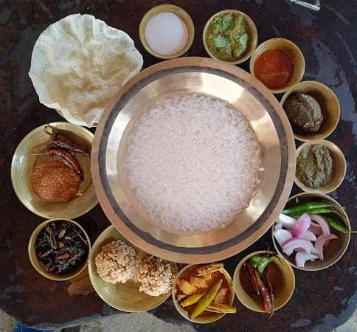
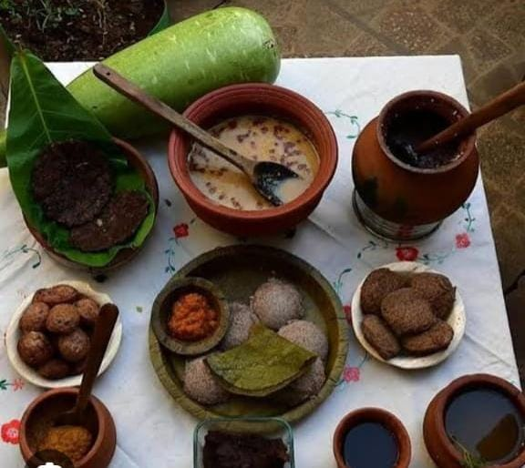
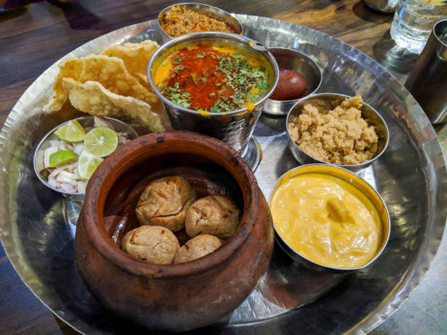
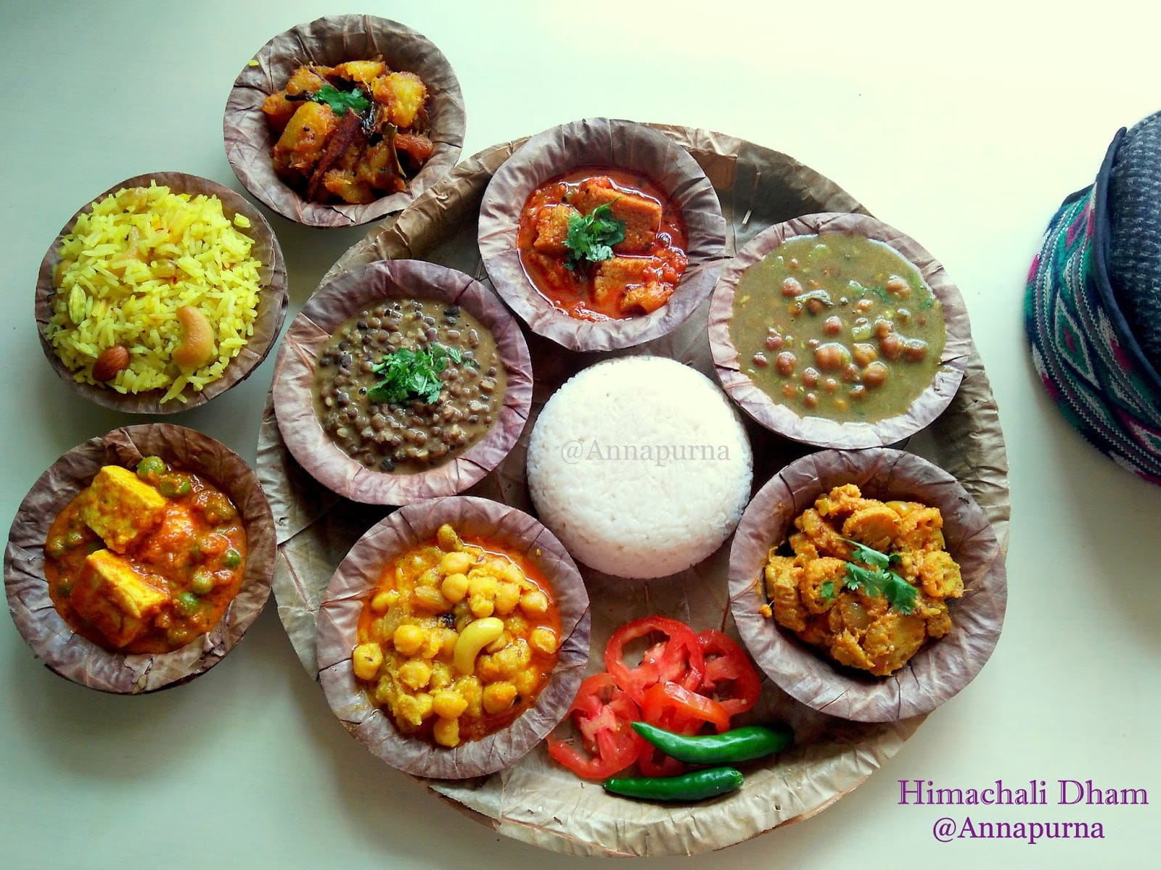
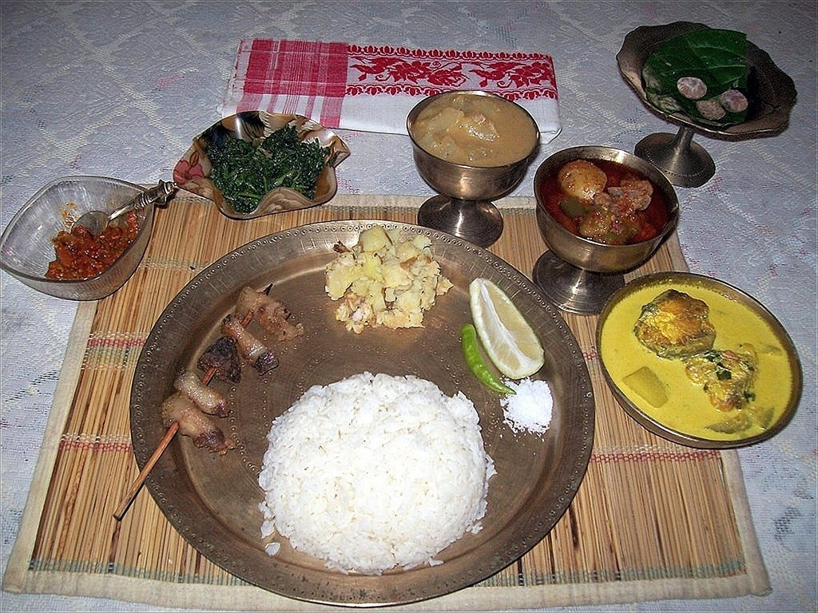
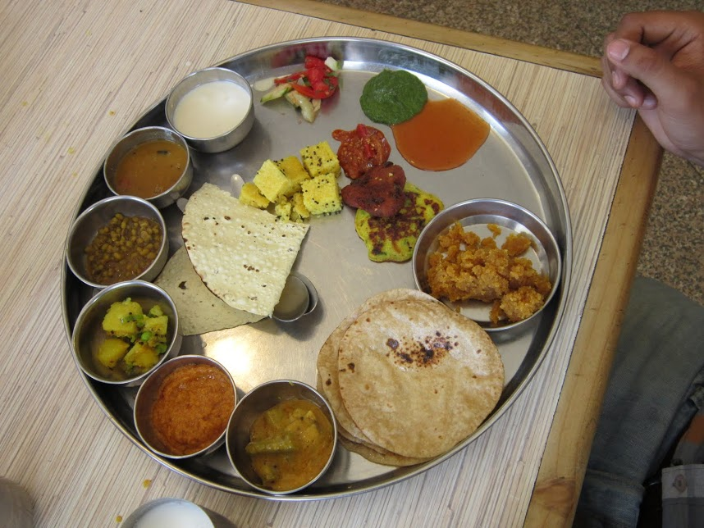
THANK YOU

